Slide 1
Project GreenBox
Creates the perfect environment for plants every time.

Slide 2

Overview
Introduction
Design details
System overview
Physical design
Circuit design
Software
Fault tree analysis diagram
Project management
Gantt chart
Budget
Conclusion

Slide 3

Introduction
Environmentally controlled box in which one can grow plants that require specific conditions to thrive.
Scalable system, but small 2’x2’x2’ box version will be created in this case.

Slide 4
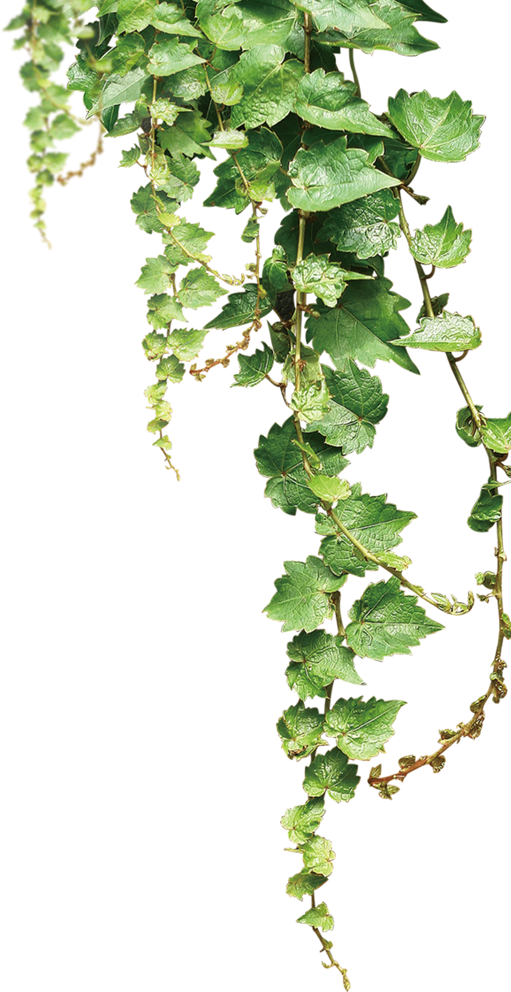
Problem
For seed germination to begin, certain conditions must be fulfilled.
Creating and maintaining these conditions can be difficult and time-consuming

Slide 5
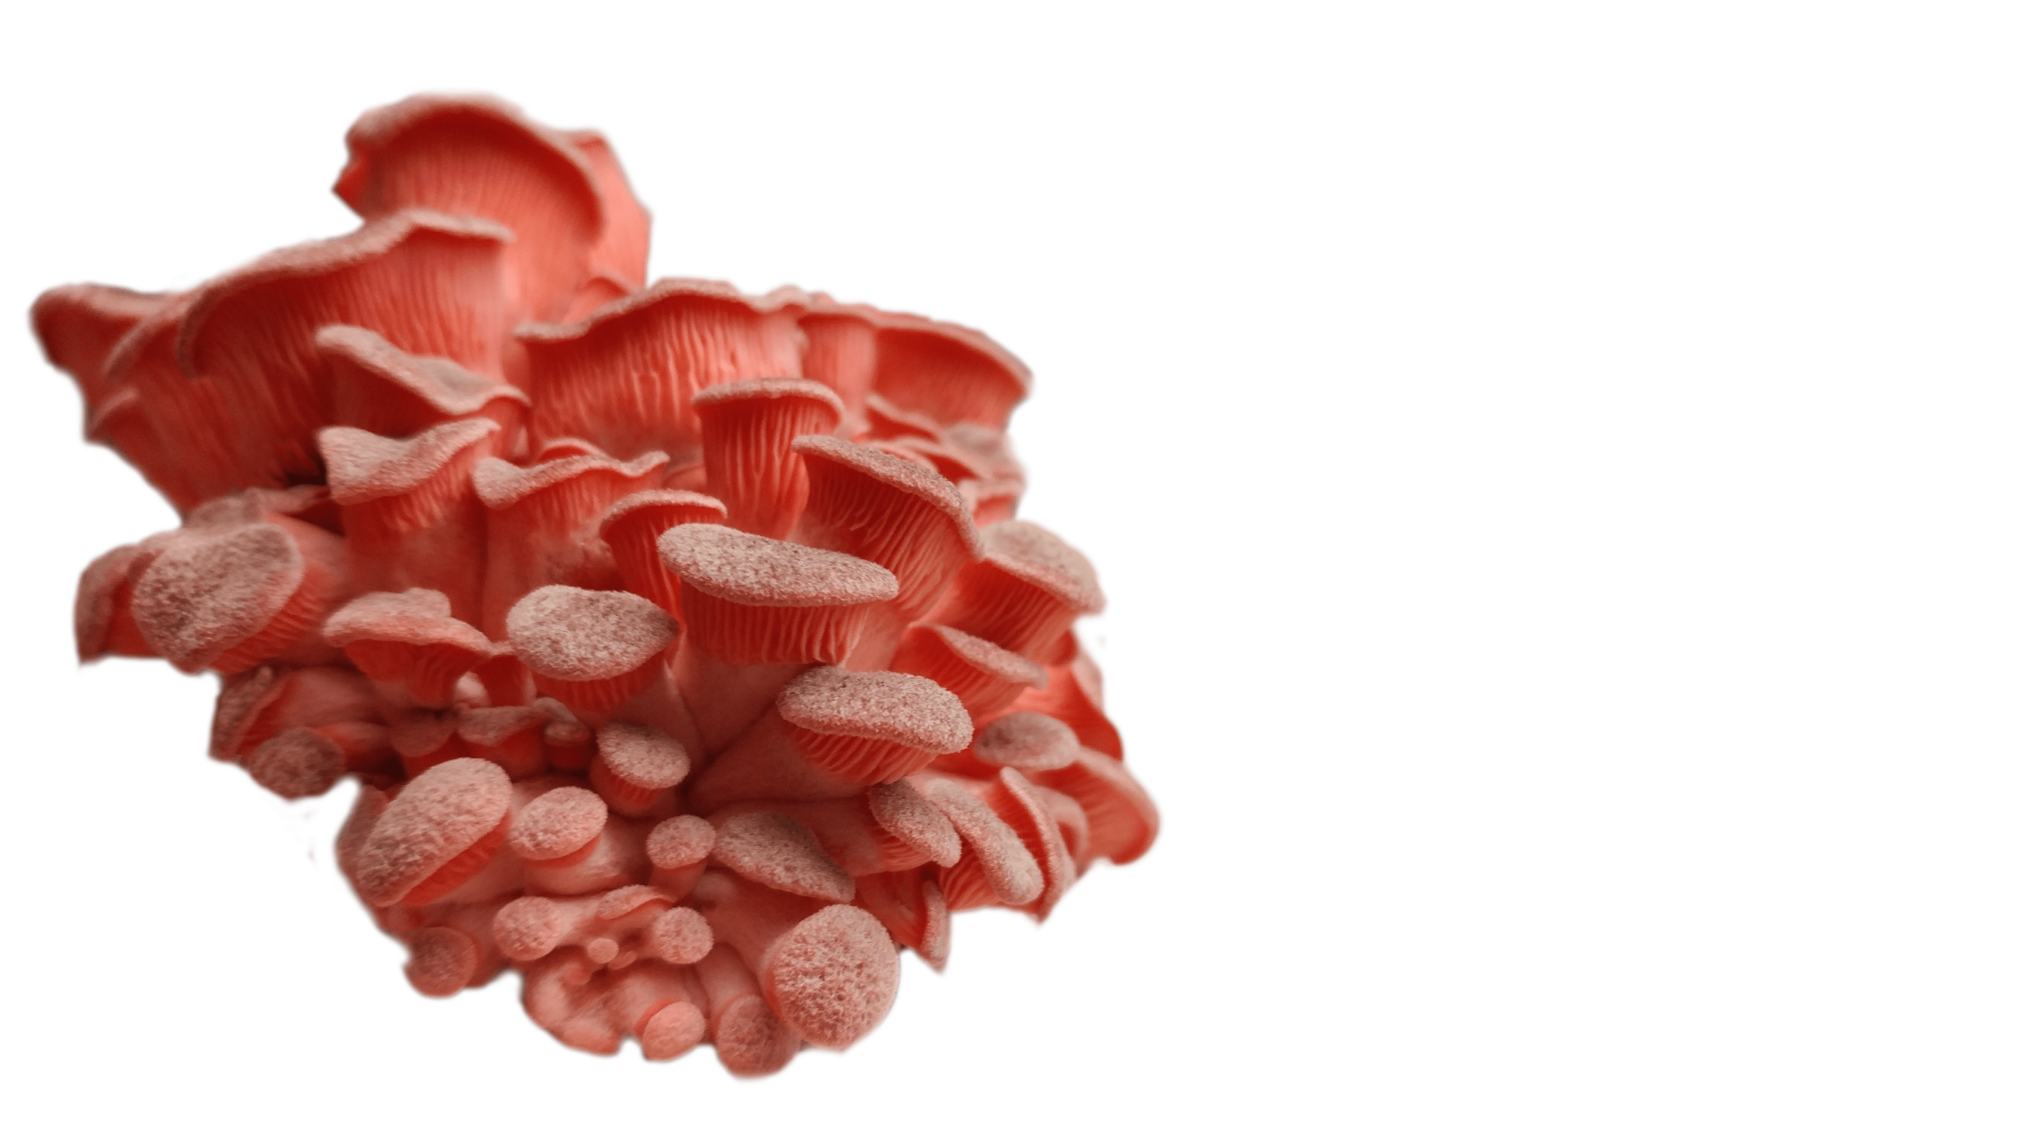
Project Impact
Allow people to raise plants in ideal conditions without putting in excessive time or effort
Easily grow things such as vegetables, house plants, mushrooms, and flowers.

Slide 6
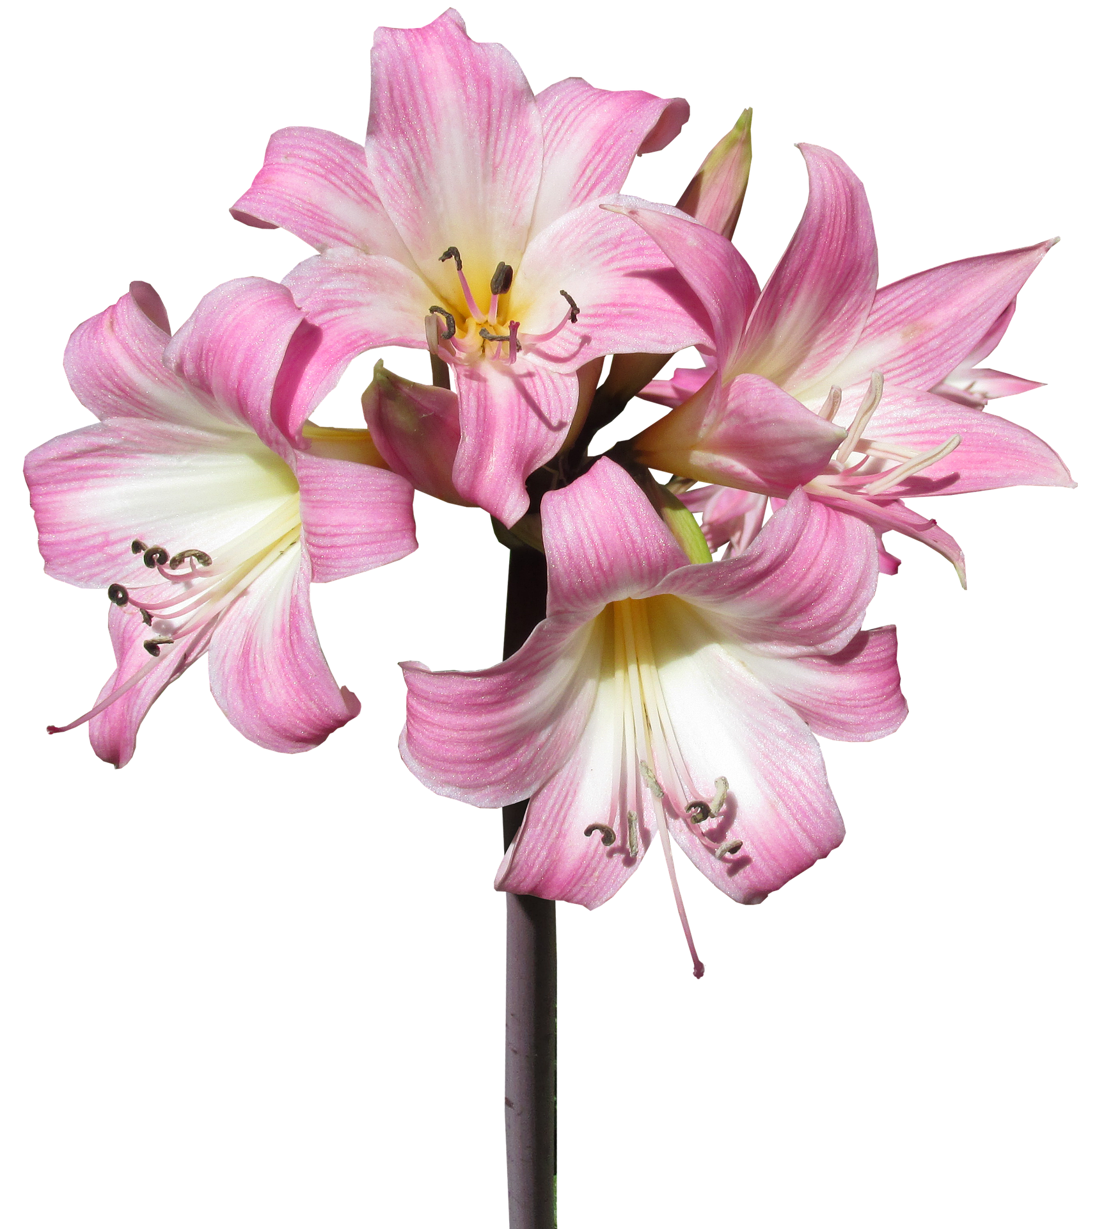
Design Details
System overview
Physical design
Circuit design
Software
Fault tree analysis diagram

Slide 7
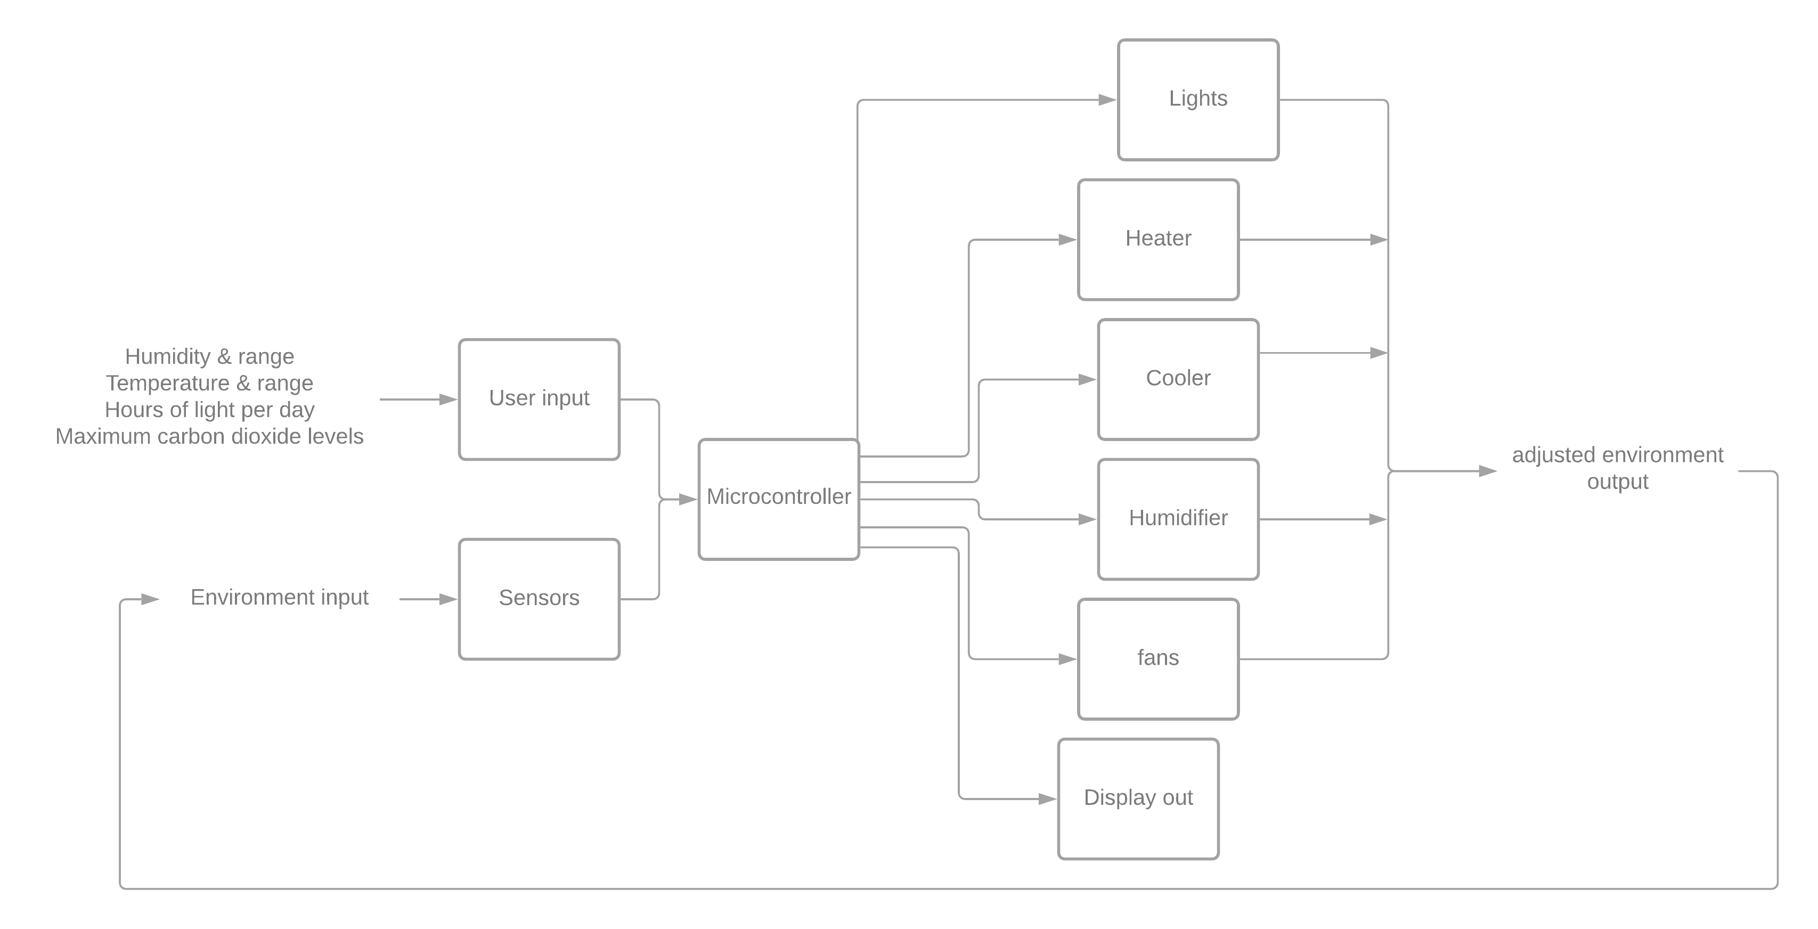
System Overview

Slide 8
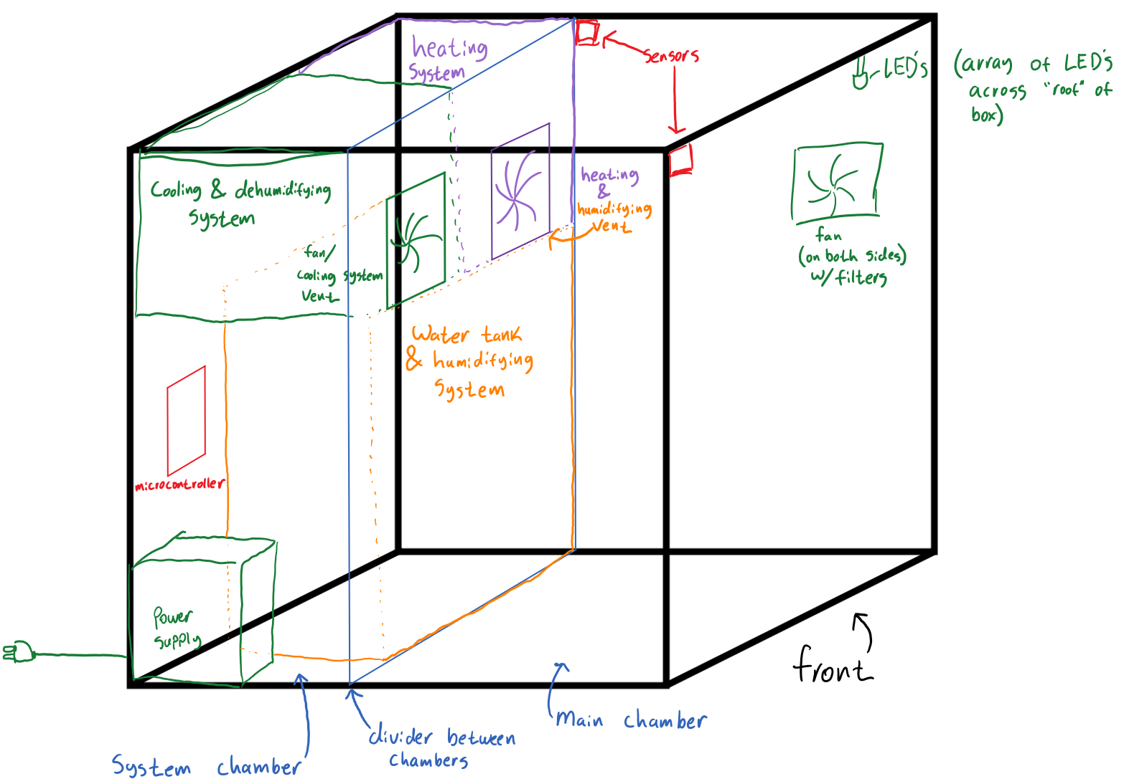
Physical Design

Slide 9
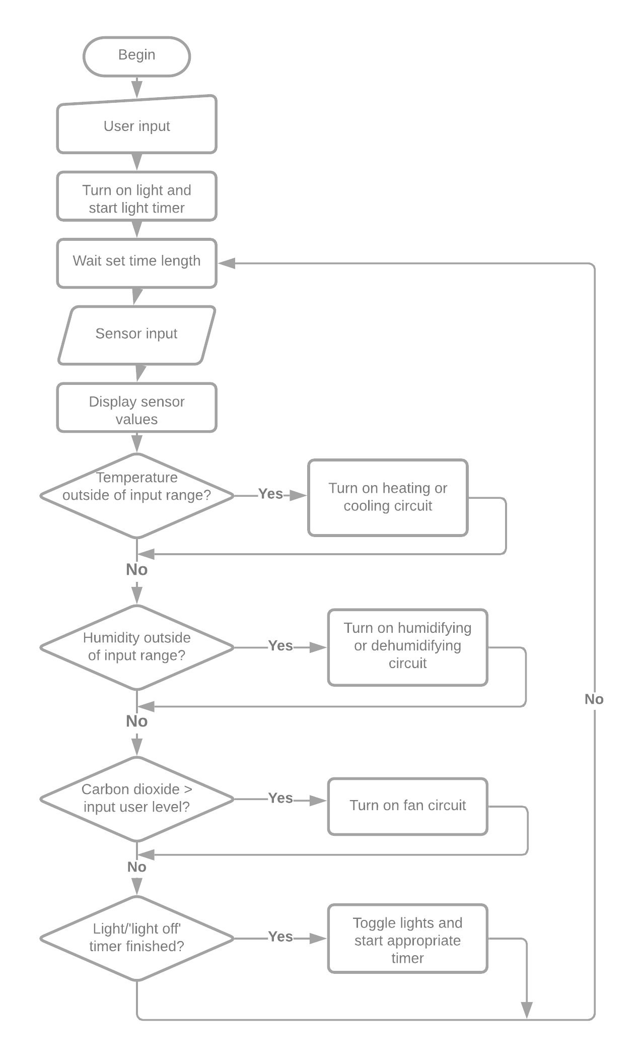
Software Design

Slide 10
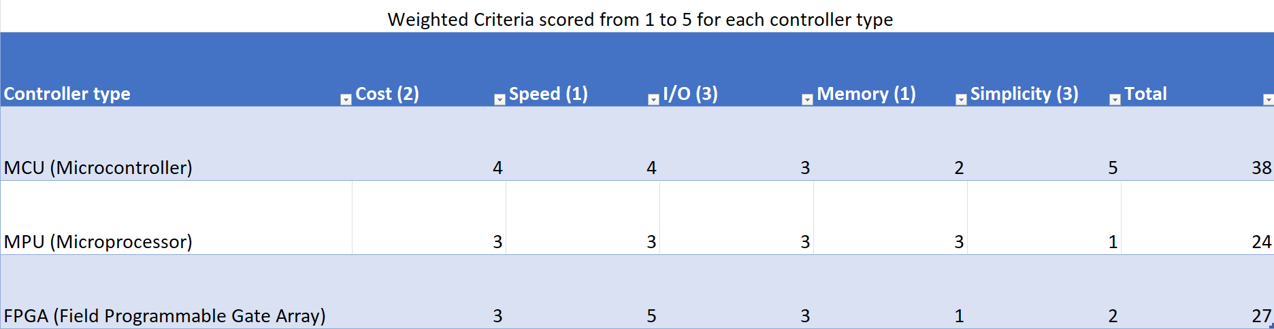
Design details: Controller

Slide 11
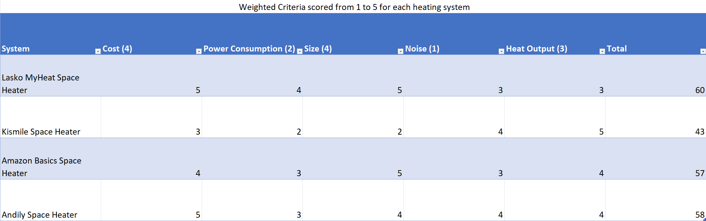
Design details: heating system

Slide 12
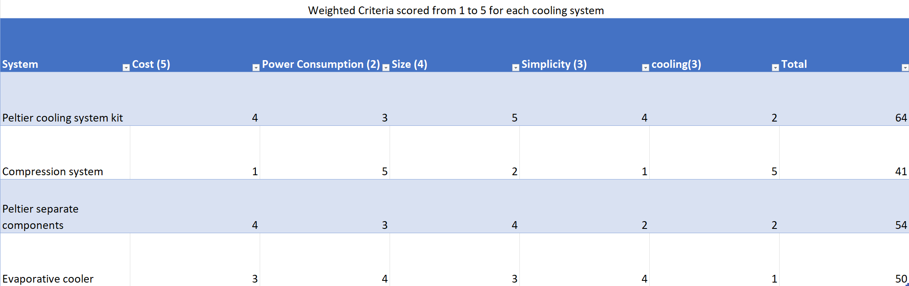
Design details: cooling system

Slide 13
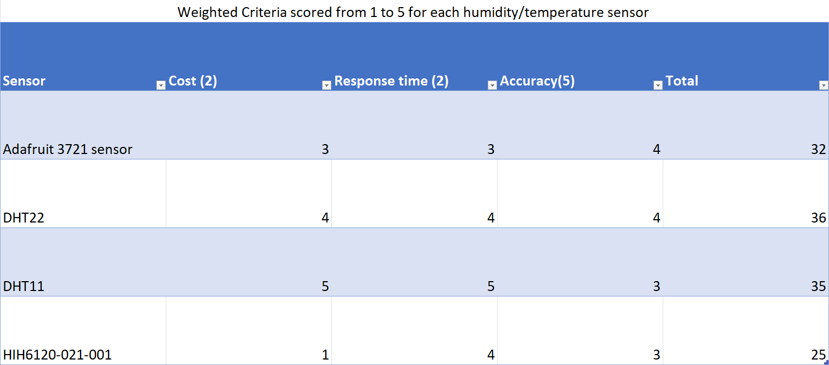
Design details: temperature/humidity sensors

Slide 14
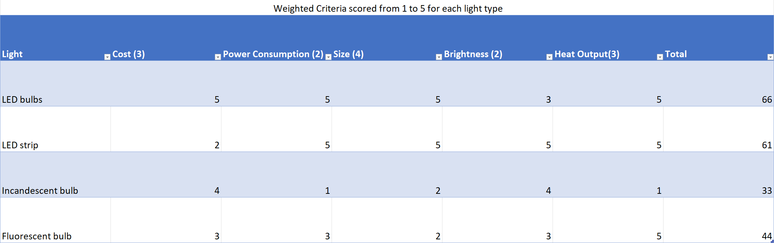
Design details: Lights

Slide 15
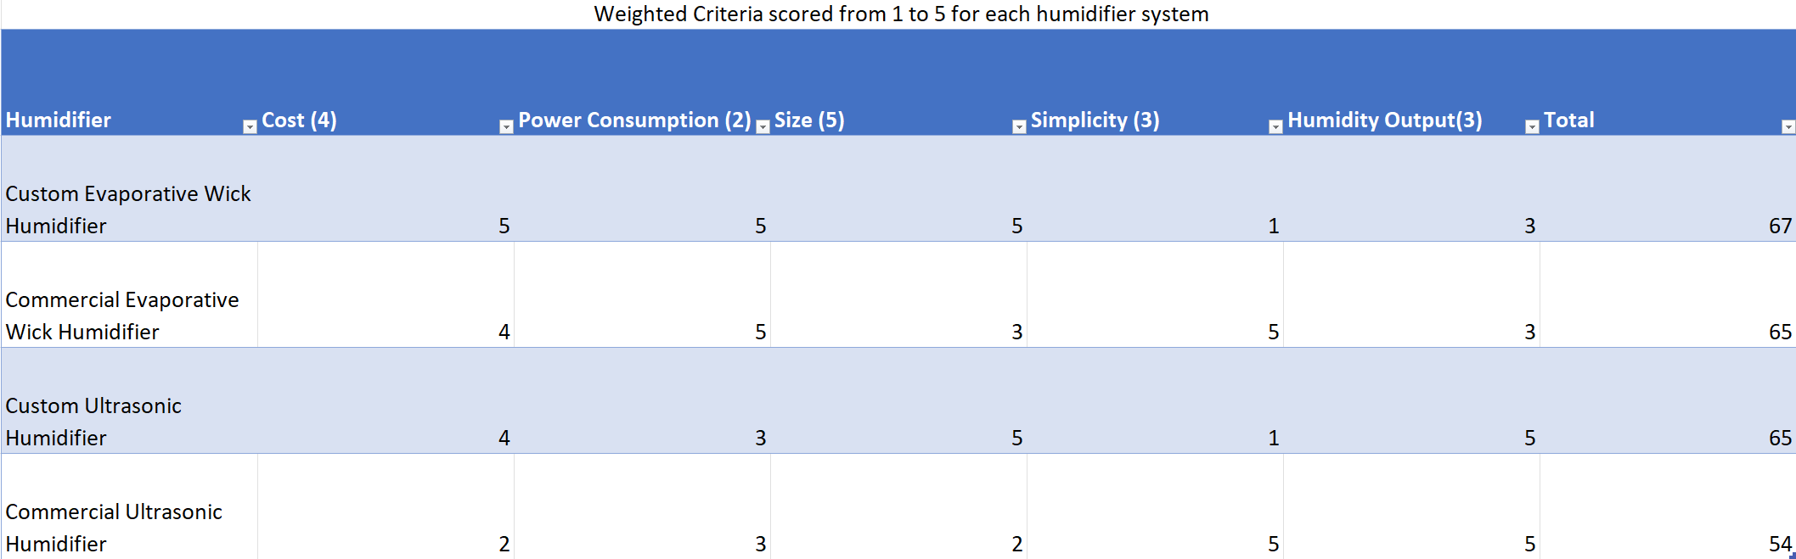
Design details: Humidifier

Slide 16
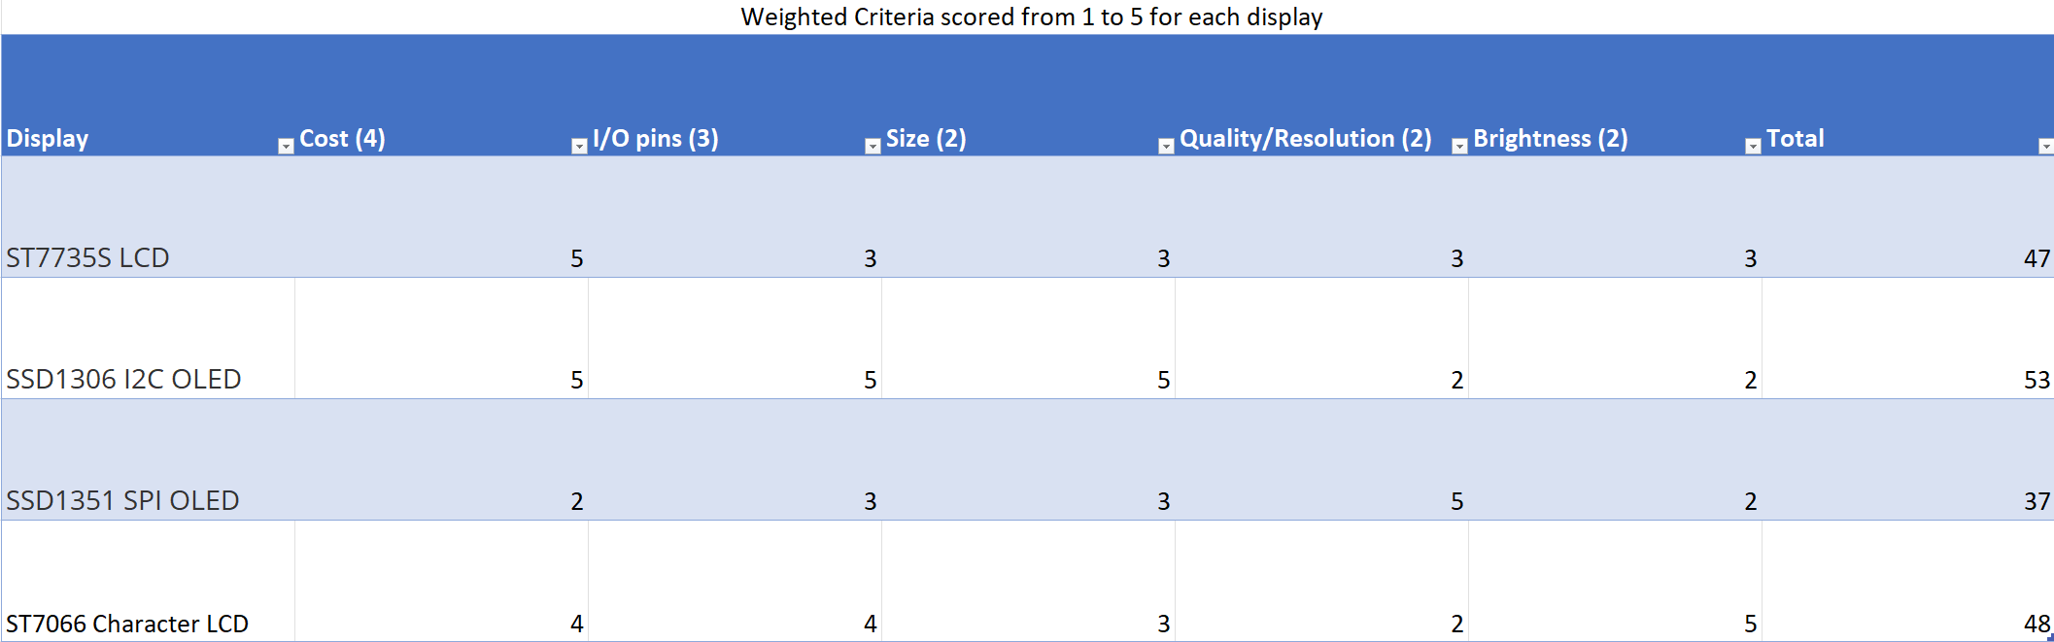
Design details: display

Slide 17
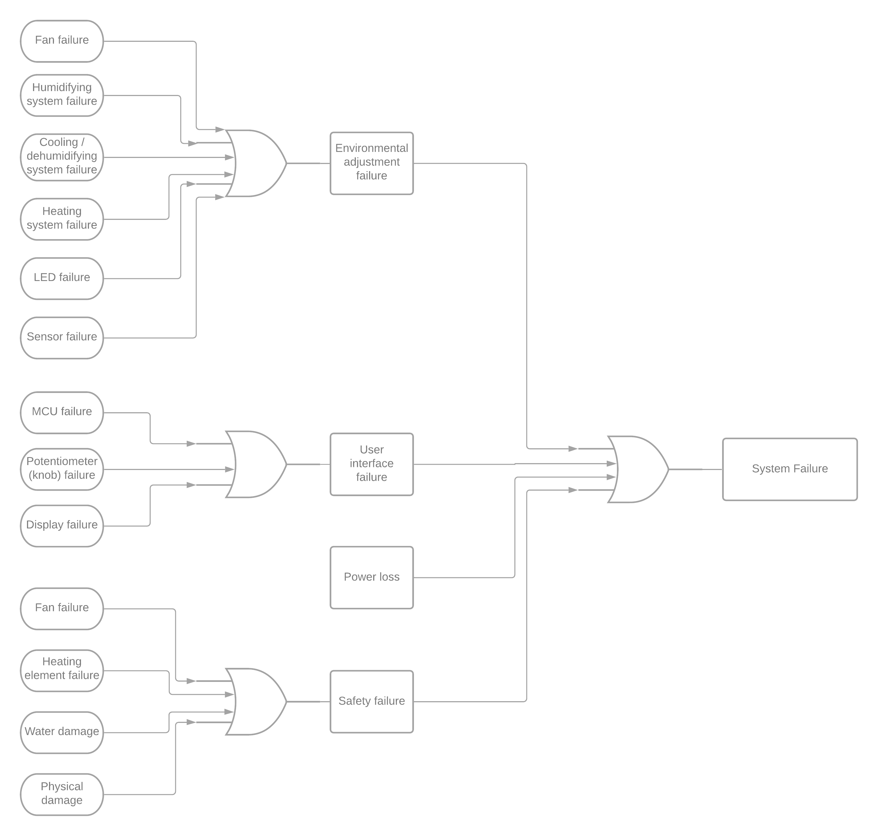
Fault Tree Analysis

Slide 18
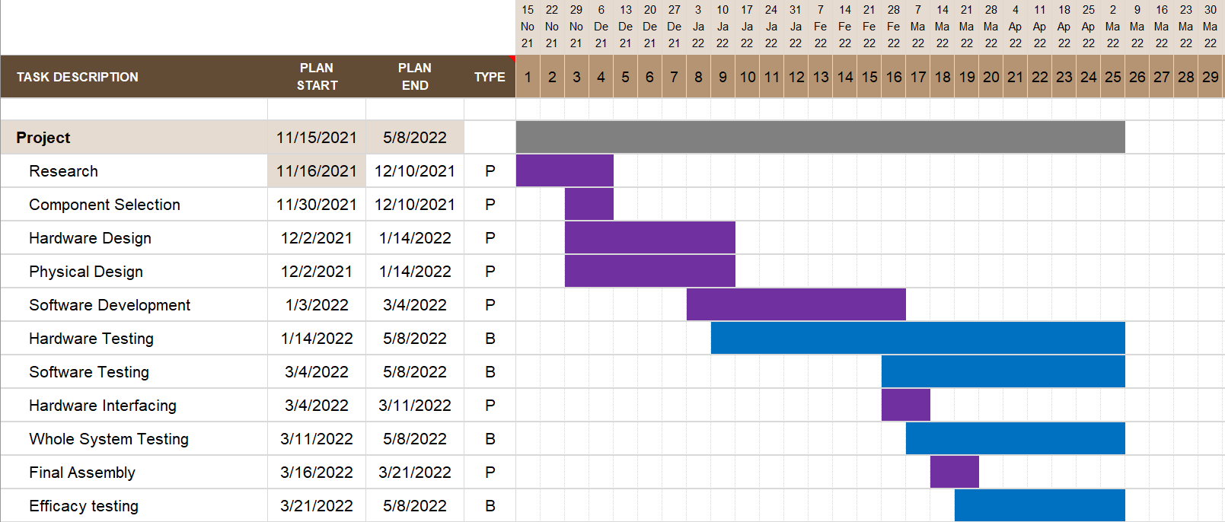
Schedule

Slide 19
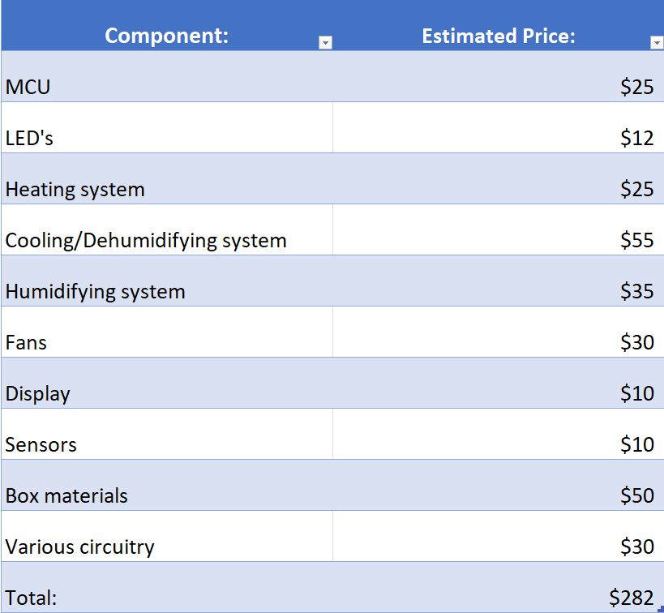
Budget

Slide 20
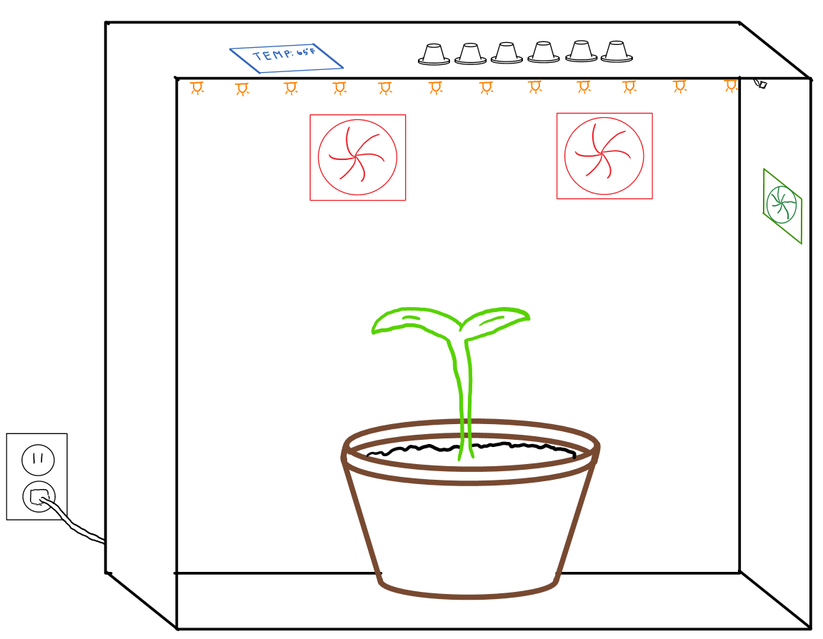
Conclusion

Slide 21
References (photos):
https://wallup.net/nature-plants-flowers-macro-depth-of-field-rose-yellow-flowers-yellow-black-background/
https://cdn2.hubspot.net/hubfs/242200/blog_images/business-growth-im.png#keepProtocol
https://www.htgsupply.com/wp-content/uploads/2019/05/shutterstock_189737078.png
https://duckduckgo.com/?q=flower&atb=v276-1&iar=images&iaf=size%3ALarge%2Ctype%3Atransparent&iax=images&ia=images&iai=https%3A%2F%2Fsnipstock.com%2Fassets%2Fcdn%2Fpng%2F4982c45b2096ce79ac3f2095c7c75df2.png
https://i1.wp.com/freshniagaramushrooms.com/wp-content/uploads/2020/01/Pink-Oyster-Mushroom-2.png?fit=5312%2C2988&ssl=1

